Slide 1



Anthony Giusti Brad Daniels David Grace Elena Castaneda

Slide 2
Questions
Is it time to ask for a raise or new job? Can economic indicators reveal your salary negotiating power?
Can economic indicators affect the regional industry?
Research various historical economic indictors to determine.

Slide 3




Data Sources and Retrieval Methods
Data Scrapping
Mortgage Origination Data
API Data Retrieval
National and Regional Unemployment and Wage Data
Data Scrapping
Historical Oil Pricing
Cushing, OK WTI Spot Price FOB
Data Scrapping
Consumers Price Index (CPI), US Employment Data and US Average Income Rates

Slide 4
Data Exploration and Cleanup Process
Bureau of Labor Statistics API contains:
system-allowed limit of 25 series
daily limits on data pulls
Limited range of data available resulting in rows with NULL values
Regional data was not listed as needed, resulting in custom grouping
Since data was collected from various sources, data had to be messaged due to frequency and data format differences.

Slide 5
Analysis Process

Slide 6
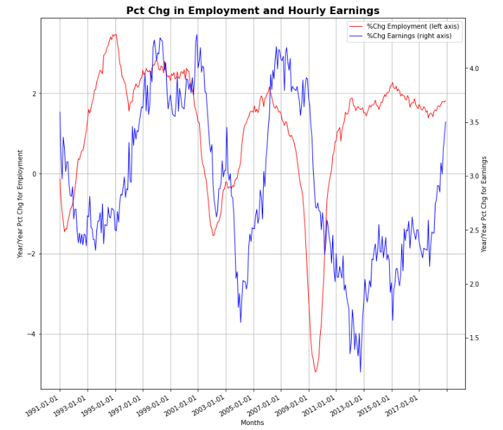
National Indexes
Percentage Change in Employment and Hourly Earnings Rate

Slide 7
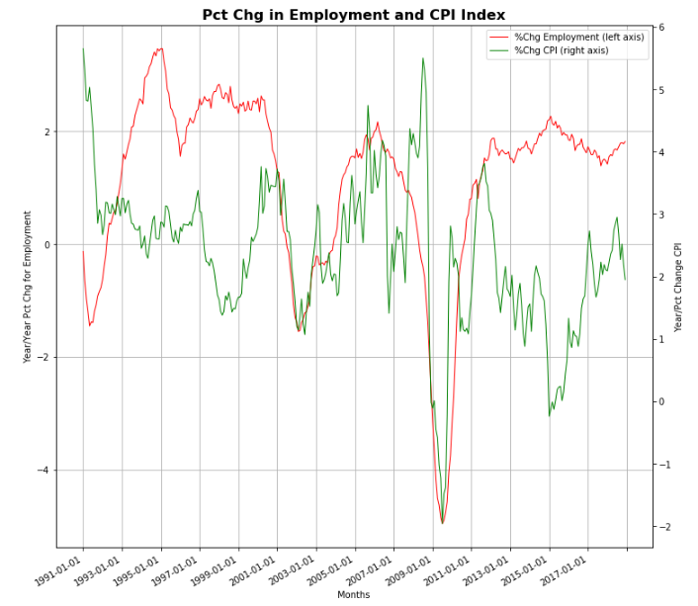
National Indexes
Percentage Change in Employment Rate and CPI Index

Slide 8
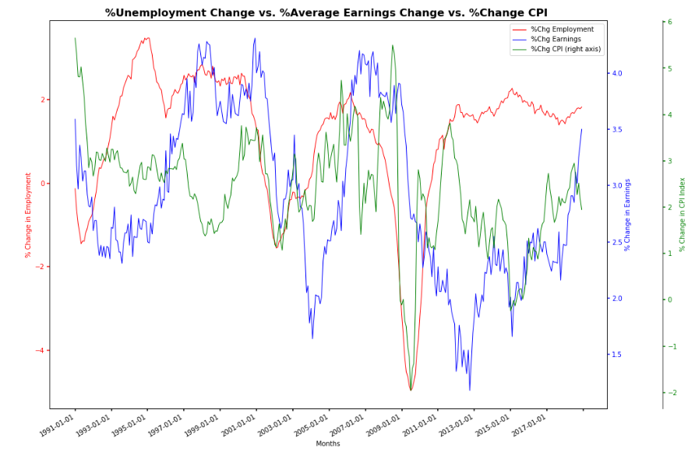
National Indexes
Percentage Change of Unemployment Rate, Average Earning and CPI Index

Slide 9
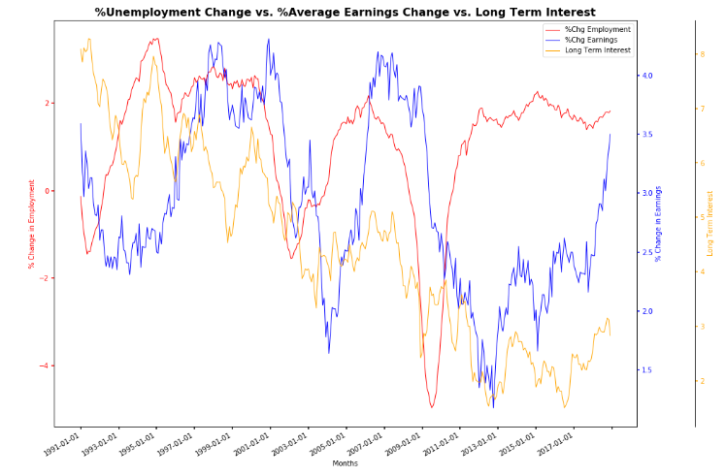
National Indexes
Percentage Change of Unemployment Rate, Average Earning and Long Term Interest Rate

Slide 10
National Indexes Conclusions

Slide 11
Regional Analysis
Financial industry in the New York Metropolitan Area
Oil industry in the Texas oil towns of Houston, Midland, Beaumont

Slide 12
New York Metropolitan Area

Slide 13
New York Metropolitan Area

Slide 14
Texas Oil Towns

Slide 15
Texas Oil Towns

Slide 16
Regional Analysis - Conclusions

Slide 17

In Closing…

